Slide 1
Welcome Back Seniors!
Music History IB

Slide 2
IB MUSIC HISTORY
"MUSIC IS THE UNIVERSAL LANGUAE OF MANKIND"
-Henry Wadsworth Longfellow, American poet

Slide 3
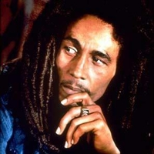
The Power of Music
“Music is ... A higher revelation than all Wisdom & Philosophy” ― Ludwig van Beethoven
“One good thing about music, when it hits you, you feel no pain.” ― Bob Marley

Slide 4
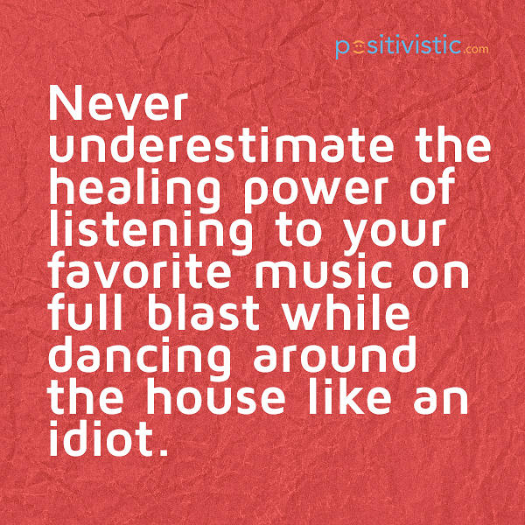
Power of Music

Slide 5
The Power Of Music
“If I were not a physicist, I would probably be a musician. I often think in music. I live my daydreams in music. I see my life in terms of music.”
​
“Music was my refuge. I could crawl into the space between the notes and curl my back to loneliness.” ​

Slide 6
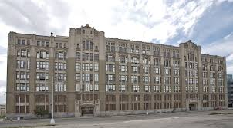
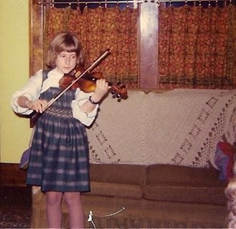
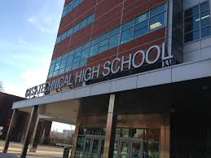
The Power of Music

Slide 7
The Power of Music
Share a personal story about how you have been influenced by music.
What value is there in learning about music in school ?
Describe your favorite pieces of music.

Slide 8
IB Music History
What is the goal of this class?
Class Syllabus
https://www.cassorchestra.weebly.com

Slide 9
Word Wall
Integrity
Attitude
Respect
Gratitude

Slide 10
IB Music History Procedures
Cell phones
Punctuality
Supplies
Seat assignments
Restroom
Communication email/remind
QUESTIONS??

Slide 11
TONIGHT 9/4/18
Check out website and go over class syllabus with you parent/guardian https://cassorchestra.weebly.com/ib-music-history-sl.html
get supplies – 3 ring binder with one tab to separate notes and homework assignments
Join REMIND @d83f32
find a memorable melody and email it to me
deanna.burrows@detroitk12.org in the subject put “yourname - Music History”
QUESTIONS???

Slide 12
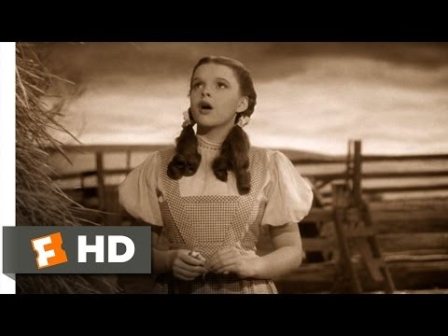
Memorable melodies
What makes a melody memorable?

